Slide 1


Python Programming for Chemical Engineers Numerical Integration
Muhammad Mufti Azis, Ph.D
Department of Chemical Engineering,
Faculty of Engineering, UGM, Indonesia

Slide 2
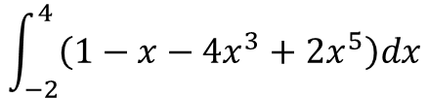
Background
We would like to solve:
Integration from a function, such as:
b. Integration from a data set, such as:
$$\int_{−2}^{4}{\left(1−x−4x^{3}+{2x}^{5}\right)dx}$$
x | F(x)=x²
1 | 1
3 | 9
5 | 25

Slide 3
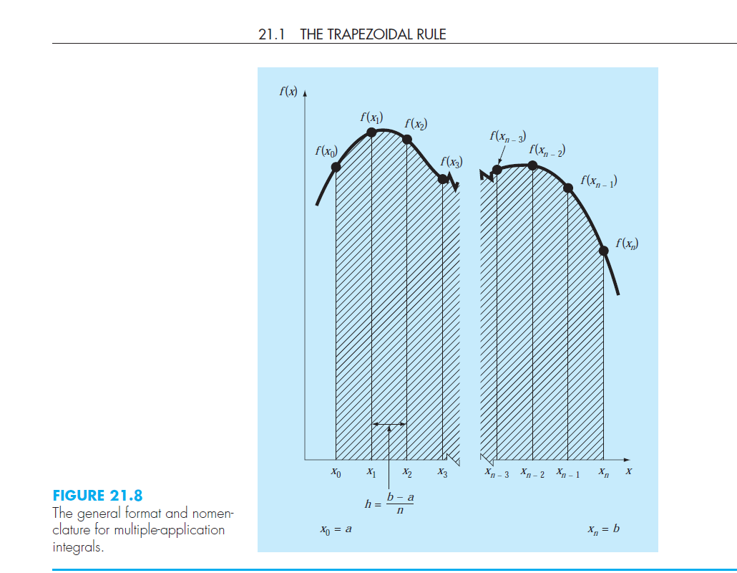
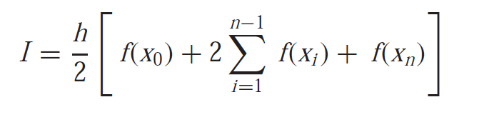
Theory
Multiple Application or Composite Trapezoidal Rule
General Formula

Slide 4
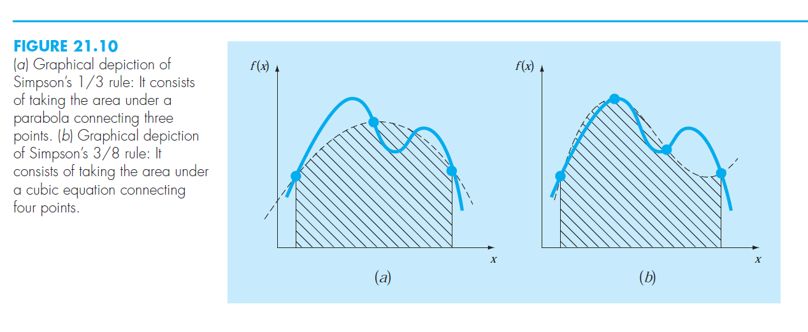
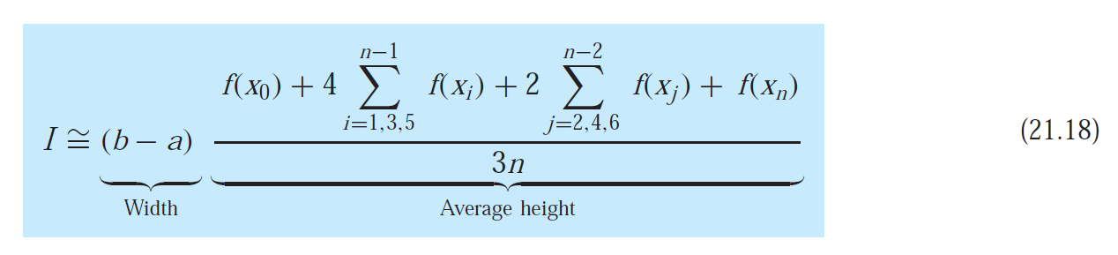
Theory
Multiple Application or Composite 1/3 rd Simpson Rule
General Formula

Slide 5
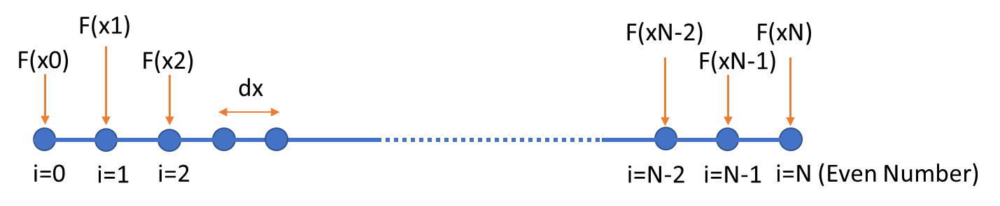
Simpson 1/3 Rule Method
General formula:
The number of discretization points should be an even number ( or in other word, the total number of points is an odd number)

Slide 6
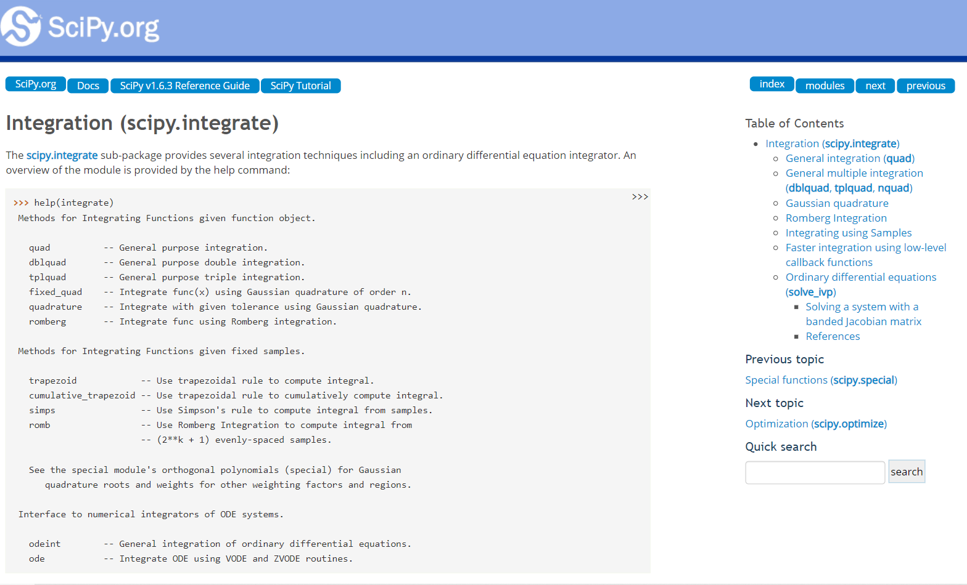
Introduction to Scipy.Integrate
https://docs.scipy.org/doc/scipy/reference/tutorial/integrate.html

Slide 7
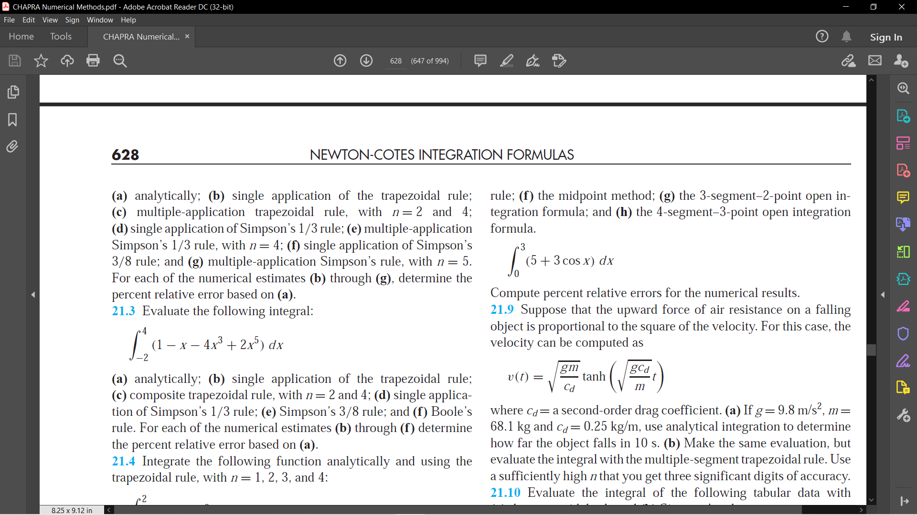
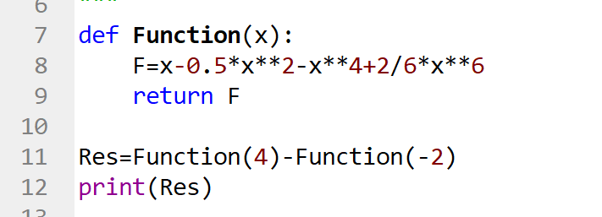
Example
Solve following equations
Analitical Solution
I=x-0.5x**2-x**4+2/6*x**6
Result=1104.0
Res=1104.0

Slide 8

Example
Solve following equations
from scipy.integrate import quad
def Myfun(x):
F=1-x-4*x**3+2*x**5
return F
Res=quad(Myfun,-2,4)
print(Res)
(1104.0, 1.2394729640791134e-11)
Result
Absolute error
Easy................

Slide 9
Example
Integrate following dataset:
x | Y
-2 | -29
-1 | 4
0 | 1
1 | -2
2 | 31
3 | 376
4 | 1789
x=np.array([-2,-1,0,1,2,3,4])
Y=np.array([-29,4,1,-2,31,376,1789])
from scipy.integrate import simps
I = simps(Y,x)
print(I)
1112.0
Easy................

Slide 10
Example
import numpy as np
def Myfun(x):
F=1-x-4*x**3+2*x**5
return F
x=np.linspace(-2,4,30)
Y=Myfun(x)
from scipy.integrate import simps
I = simps(Y,x)
print(I)
We divide 30 points between -2 and 4
Result=1104.769208979955
Very close to analytical solution

Slide 11
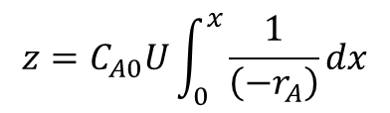
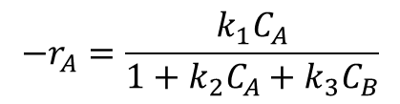
Exercise Problem
A catalytic reaction A (g) → B (g) is carried out in an isothermal circulating fluidized bed reactor. For reactions with surface-limited reaction mechanism, where A and B are absorbed on the surface of the catalyst, the reaction rate equation is:
The rA is the reaction rate in kmol/m³.s, CA and CB are concentrations of A and B in kmol/m³. Parameter k1, k2 and k3 represents the reaction rate constant. It is also assumed that the catalyst moves upward at the same velocity as the gas of U m/s.
From mass balance in the reactor, we can estimate the height of the reactor as a function of conversion as:
With: CA = CA0 (1-X) and CB = CB0 (1+X)
Calculation data: CA0=0.2 kmol/m³, CB0=0, U=7.5 m/s, k1 = 8 s⁻¹, k2 = 3 m³/kmol, and k3 = 0.01 m³/kmol .
Make a table and graph which shows z and x in the range of: 0≤x≤0.9
$$−r_{A}=\frac{k_{1}C_{A}}{1+k_{2}C_{A}+k_{3}C_{B}}$$
$$z=C_{A0}U\int_{0}^{x}{\frac{1}{\left(−r_{A}\right)}dx}$$

Slide 12

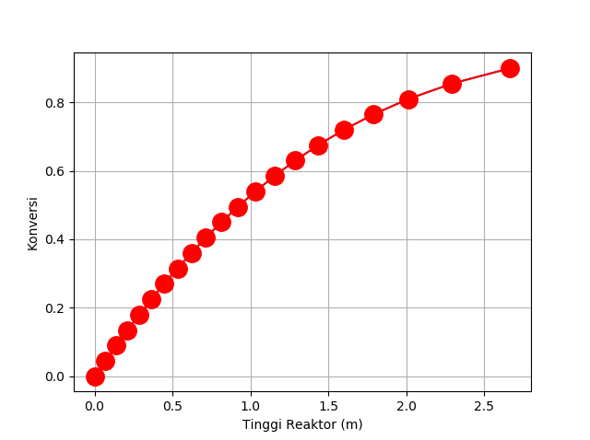


Program Structure
#Main program
#Data
…
#Calculation process
Prepare a vector of xfinal
for loop to access each value of xfinal
…
#Plotting and prepare table
xfinal
X
Function to calculate Y
CA=CA0*(1-X)
…
rA=…
Y=1/rA
Program
Simpson
Integration result
2
3
Y
1
Integration result xf [1]
Integration result xf [2]
…
Integration result xf [N]

